Slide 1
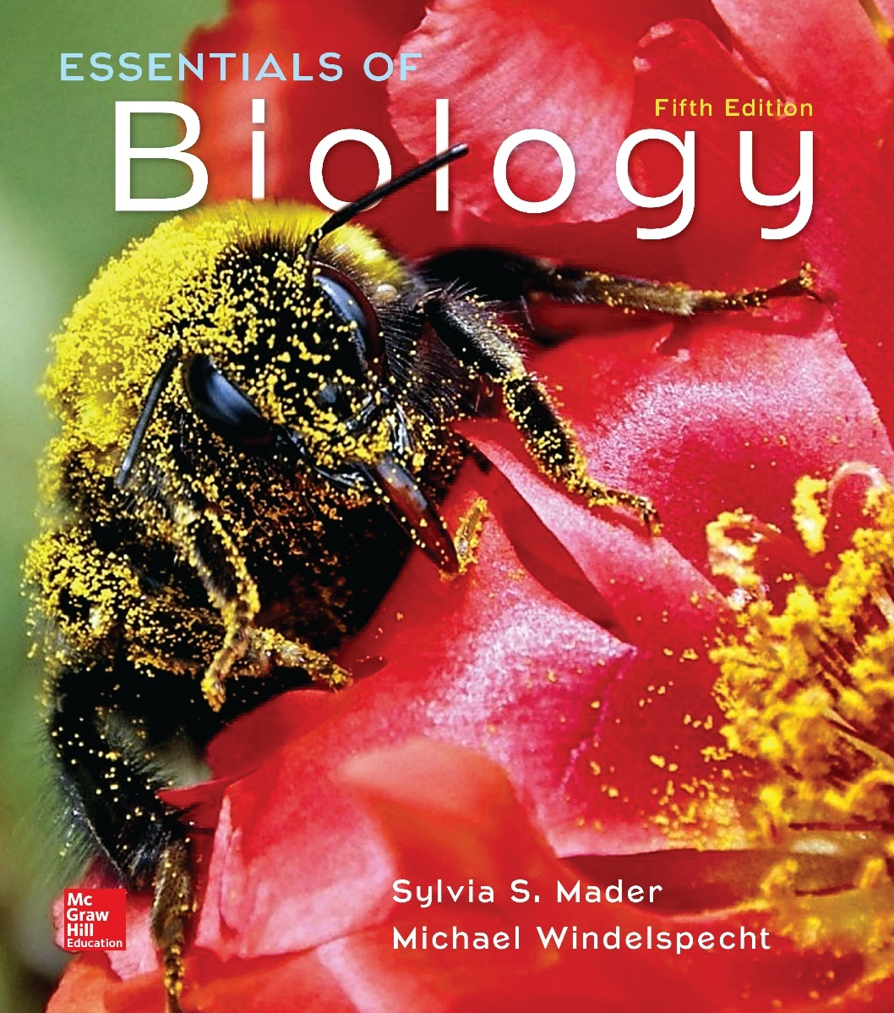
Essentials of Biology
Sylvia S. Mader Michael Windelspecht
Chapter 10 Patterns of Inheritance
Lecture Outline
See separate FlexArt PowerPoint slides for all figures and tables pre-inserted into PowerPoint without notes.
Copyright © McGraw-Hill Education. All rights reserved. Authorized only for instructor use in the classroom. No reproduction or distribution without the prior written consent of McGraw-Hill Education.
Notes:
1

Slide 2
10.1 Mendel’s Laws
Gregor Mendel
Austrian monk
Worked with garden pea plants in 1860s
When he began his work, most acknowledged that both sexes contributed equally to a new individual.
Unable to account for presence of variations among members of a family over generations
Mendel’s model compatible with evolution
Various combinations of traits are tested by the environment.
Combinations that lead to reproductive success are the ones that are passed on.

Slide 3
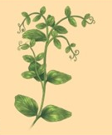
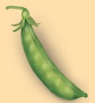
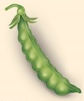
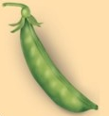
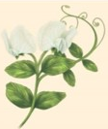
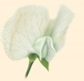
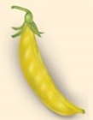
Figure 10.1 Mendel Working in His Garden
Trait
Stem length
Pod shape
Characteristics-Dominant
Tall
Inflated
Characteristics-Recessive
Short
Constricted
a: © Ned M. Seidler/National Geographic Creative
Trait
Seed shape
Seed color
Flower position
Flower color
Pod color
Round
Yellow
Axial
Purple
Green
Wrinkled
Green
Terminal
White
Yellow

Slide 4
Mendel’s Experimental Procedure
Mendel’s experimental procedure
Used garden pea, Pisum sativa
Easy to cultivate, short generation time
Normally self-pollinates but can be cross-pollinated by hand
Chose true-breeding varieties—offspring were like the parent plants and each other
Kept careful records of large number of experiments
His understanding of mathematical laws of probability helped interpret results.
Particulate theory of inheritance—based on the existence of minute particles (genes)

Slide 5
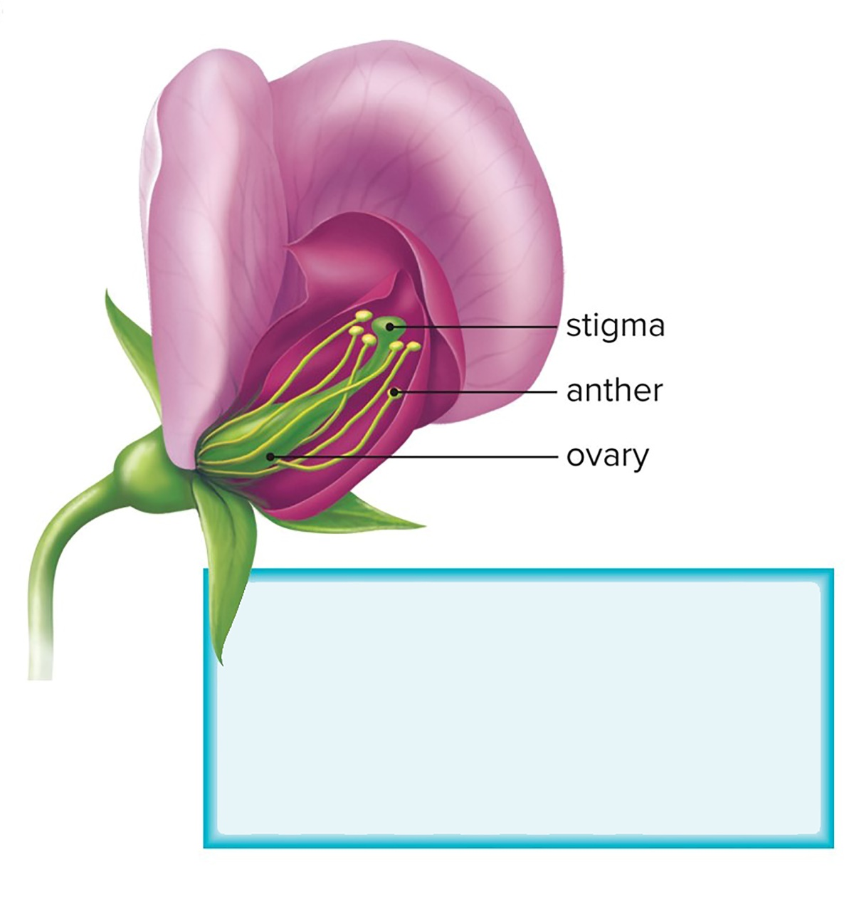
Figure 10.2a Garden Pea Anatomy and Traits
Pollen grains containing sperm are produced in the anther. When pollen grains are brushed onto the stigma, sperm fertilizes eggs in the ovary. Fertilized eggs are located in ovules, which develop into seeds.
Flower structure

Slide 6
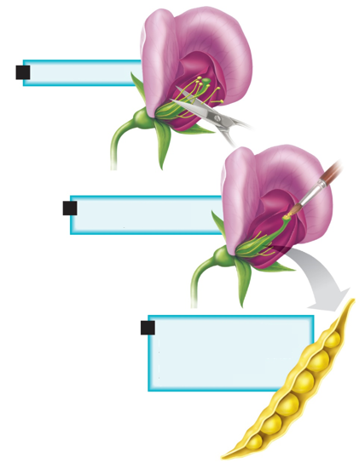
Figure 10.2b Garden Pea Anatomy and Traits
Cut away anthers.
Brush on pollen from another plant.
The results of cross from a parent that produces round, yellow seeds x parent that produces wrinkled yellow seeds.
Cross-pollination

Slide 7
One-Trait Inheritance
One-trait inheritance
Original parents called P generation
First-generation offspring $F_{1}$ generation
Second-generation offspring $F_{2}$ generation
Crossed green pod plants with yellow pod plants
All $F_{1}$ are green pods
Had yellow pods disappeared?

Slide 8
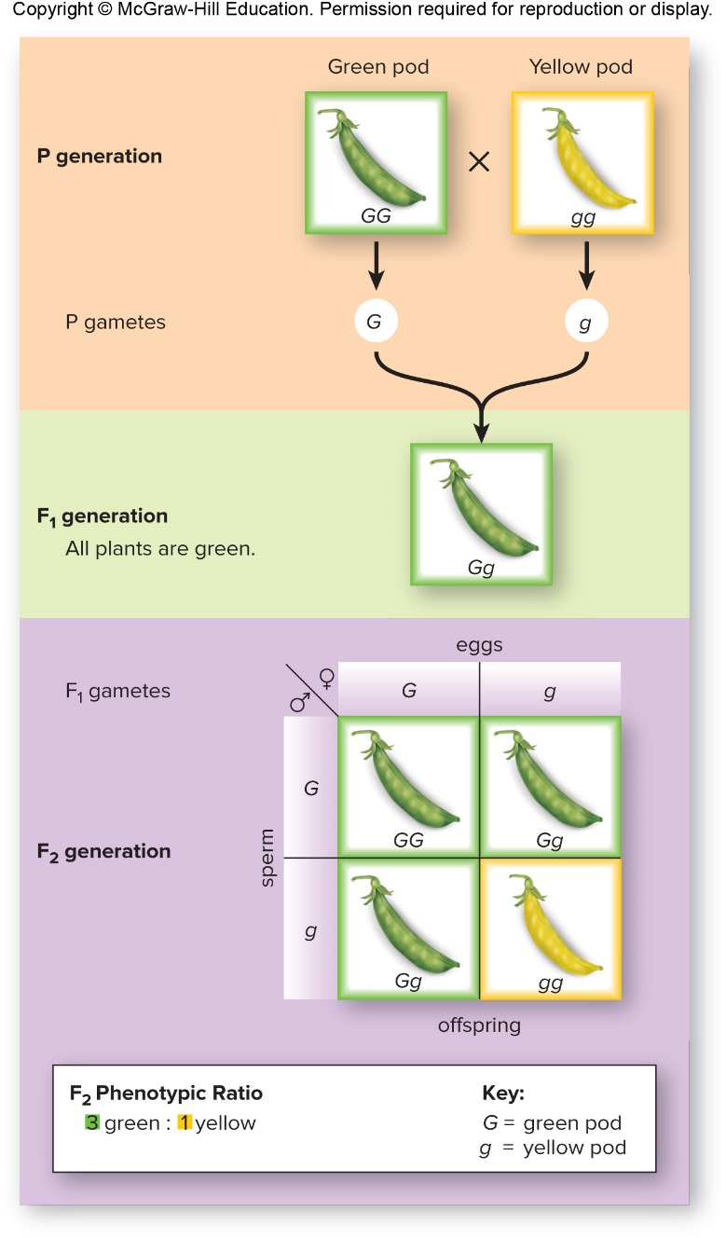
Figure 10.3 One-Trait Cross

Slide 9
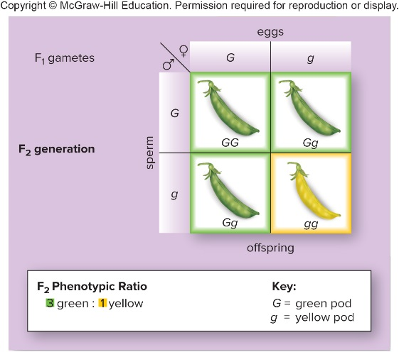
Punnett Square
Punnett square
Shows all possible combinations of egg and sperm offspring may inherit
When $F_{1}$ allowed to self-pollinate, $F_{2}$ were 3/4 green and 1/4 yellow
$F_{1}$ had passed on yellow pods

Slide 10
Mendel’s Interpretation
Mendel reasoned 3:1 ratio only possible if:
$F_{1}$ parents contained two separate copies of each heritable factor
(1 dominant and 1 recessive)
Factors separated when gametes were formed and each gamete carried only one copy of each factor
Random fusion of all possible gametes occurred at fertilization

Slide 11
One-Trait Testcross, 1
One-trait testcross
To see if the $F_{1}$ carries a recessive factor, Mendel crossed his $F_{1}$ generation green pod plants with true-breeding, yellow pod plants.
He reasoned that half the offspring would be green and half would be yellow.
His hypothesis that factors segregate when gametes are formed was supported.
Testcross
Used to determine whether or not an individual with the dominant trait has two dominant factors for a particular trait

Slide 12
One-Trait Testcross, 2
One-trait testcross, continued
If a parent with the dominant phenotype has only one dominant factor, the results among the offspring are 1:1.
If a parent with the dominant phenotype has two dominant factors, all offspring have the dominant phenotype.

Slide 13
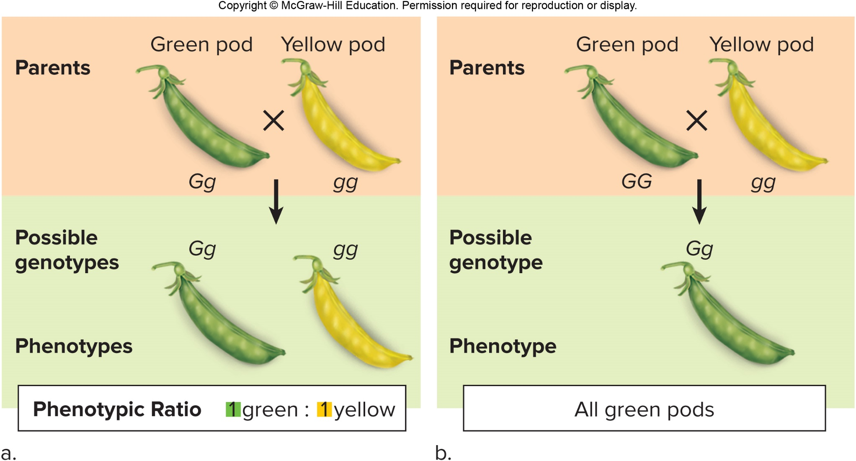
Figure 10.4 One-Trait Testcross

Slide 14
Mendel’s First Law
Mendel’s first law of inheritance—law of segregation
Cornerstone of his particulate theory of inheritance
The law of segregation states the following:
Each individual has two factors for each trait
The factors segregate (separate) during the formation of the gametes
Each gamete contains only one factor from each pair of factors
Fertilization gives each new individual two factors for each trait

Slide 15
Modern Interpretation of Mendel’s Work
Modern Interpretation of Mendel’s Work
Scientists note parallel between Mendel’s particulate factors and chromosomes
Chromosomal theory of inheritance
Chromosomes are carriers of genetic information.
Traits are controlled by discrete genes that occur on homologous pairs of chromosomes at a gene locus.
Each homologue holds one copy of each gene pair.
Meiosis explains Mendel’s law of segregation and why only one gene for each trait is in a gamete.
When fertilization occurs, the resulting offspring again have two genes for each trait, one from each parent.

Slide 16
Alleles
Alleles—alternative forms of a gene
Dominant allele masks the expression of the recessive allele
For the most part, an individual’s traits are determined by the alleles inherited.
Alleles occur on homologous chromosomes at a particular location called the gene locus.

Slide 17
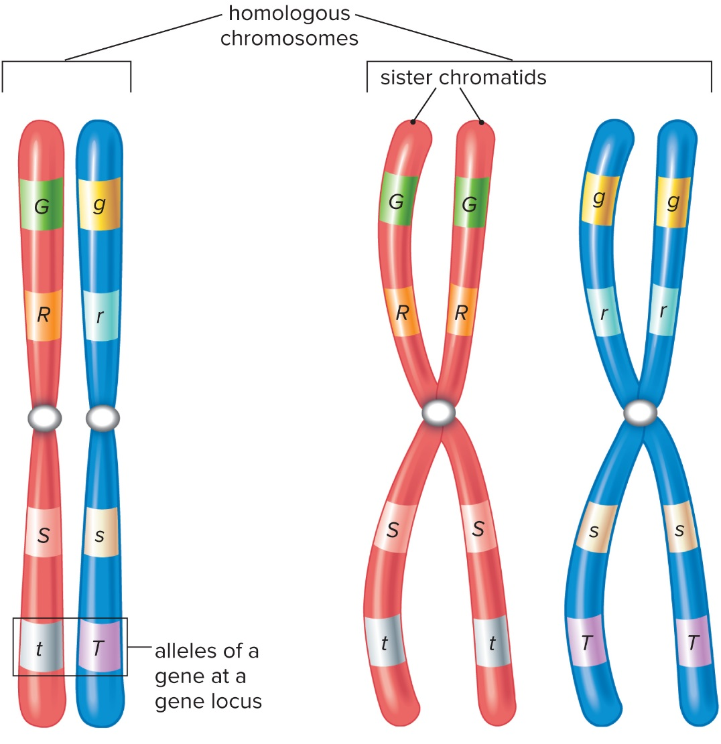
Figure 10.5 Homologous Chromosomes
Various alleles are located at specific loci.
Duplicated chromosomes show that sister chromatids have identical alleles.

Slide 18
Genotype Versus Phenotype
Genotype versus phenotype
Genotype—alleles the individual receives at fertilization
Homozygous—two identical alleles
Homozygous dominant
Homozygous recessive
Heterozygous—two different alleles
Phenotype—physical appearance of the individual
Mostly determined by genotype

Slide 19
Table 10.1 Genotype Versus Phenotype
Table 10.1 Genotype versus Phenotype
Allele Combination | Genotype | Phenotype
AA | Homozygous dominant | Normal pigmentation
Aa | Heterozygous | Normal pigmentation
aa | Homozygous recessive | Albinism

Slide 20
Two-Trait Inheritance
Two-trait inheritance
Mendel crossed tall plants with green pods (TTGG) with short plants with yellow pods (ttgg).
$F_{1}$ plants showed both dominant characteristics—tall and green pods.
Two possible results for $F_{2}$
If the dominant factors always go into gametes together, $F_{2}$ will have only two phenotypes.
Tall plants with green pods
Short plants with yellow pods
If four factors segregate into gametes independently, four phenotypes would result.

Slide 21
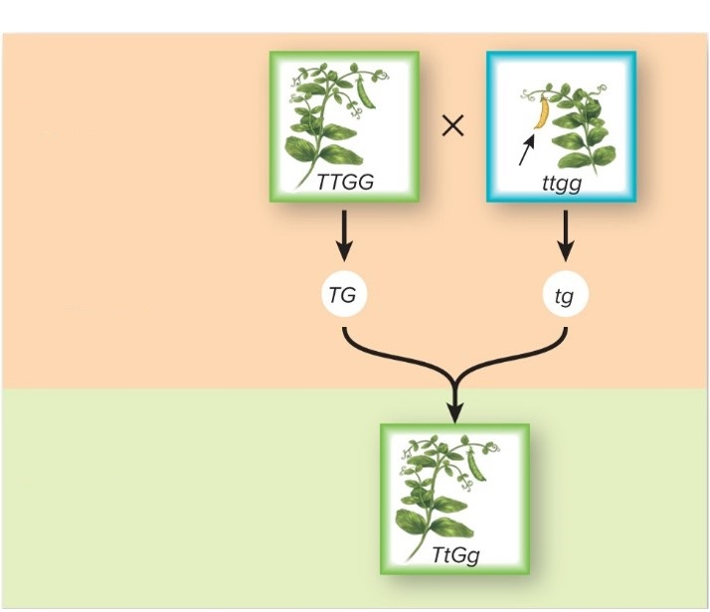
Figure 10.6 Two-Trait Cross by Mendel, 1
P generation
P gametes
$F_{1}$ generation
All plants are tall with green pods.

Slide 22
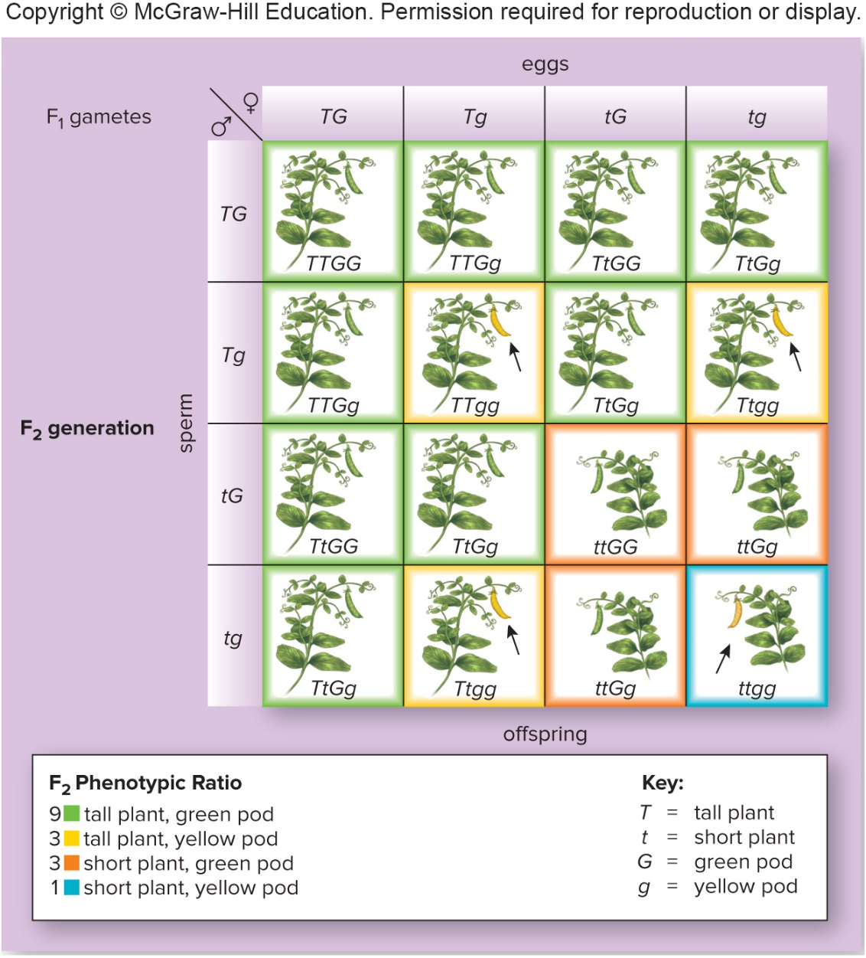
Figure 10.6 Two-Trait Cross by Mendel, 2

Slide 23
Mendel’s Second Law of Heredity
Based on the results, Mendel formulated his second law of heredity.
Law of independent assortment
Each pair of factors segregates (assorts) independently of the other pairs.
All possible combinations of factors can occur in the gametes.
When all possible sperm have an opportunity to fertilize all possible eggs, the expected phenotypic results of a two-trait cross are always 9:3:3:1.

Slide 24
Two-Trait Testcross
Two-trait testcross in fruit fly
Fruit fly Drosophila melanogaster
Used in genetics research
Wild-type fly has long wings and gray body
Some mutants have vestigial wings and ebony bodies.
L= long, l = short, G = gray, g = black
Can’t determine genotype of long-winged gray-bodied fly (L_G_)
Cross with short-winged black-bodied fly (llgg)

Slide 25
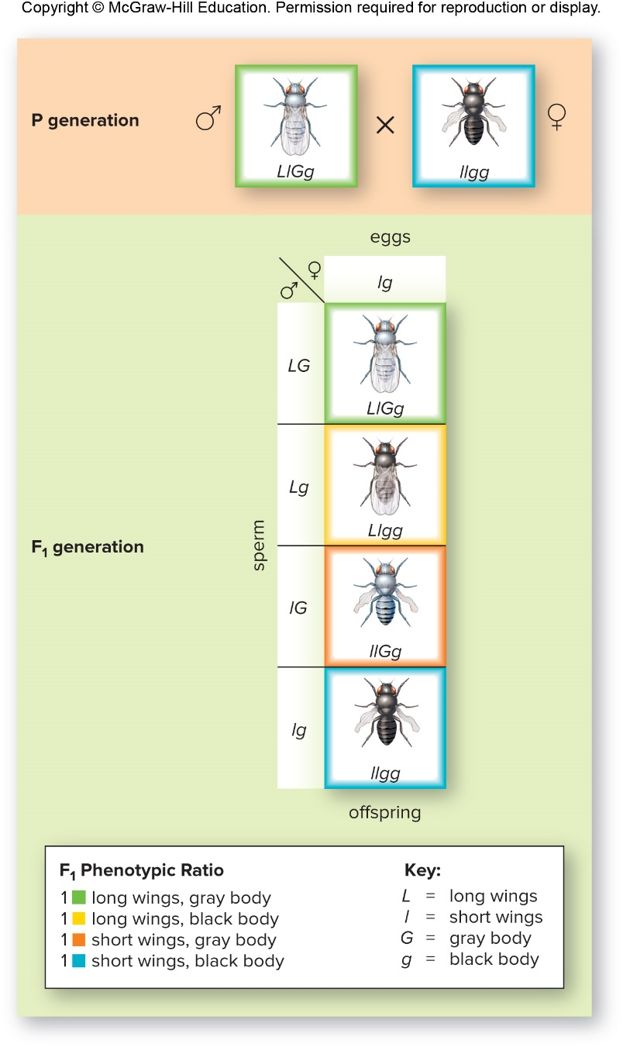
Figure 10.7 Two-Trait Testcross
In this example, 1:1:1:1 ratio of offspring indicates L_G_ fly was LlGg (dihybrid).

Slide 26
Mendel’s Laws and Probability
Mendel’s laws and probability
Punnett square assumes:
Each gamete contains one allele for each trait
Law of segregation
Collectively the gametes have all possible combinations of alleles
Law of independent assortment
Male and female gametes combine at random
Use rules of probability to calculate expected phenotype ratios
Rule of multiplication—chance of two (or more) independent events occurring together is the product of their chances of occurring separately
Coin flips—odd of getting tails is $1/2$, odds of getting tails when you flip 2 coins $1/2×1/2=1/4$

Slide 27
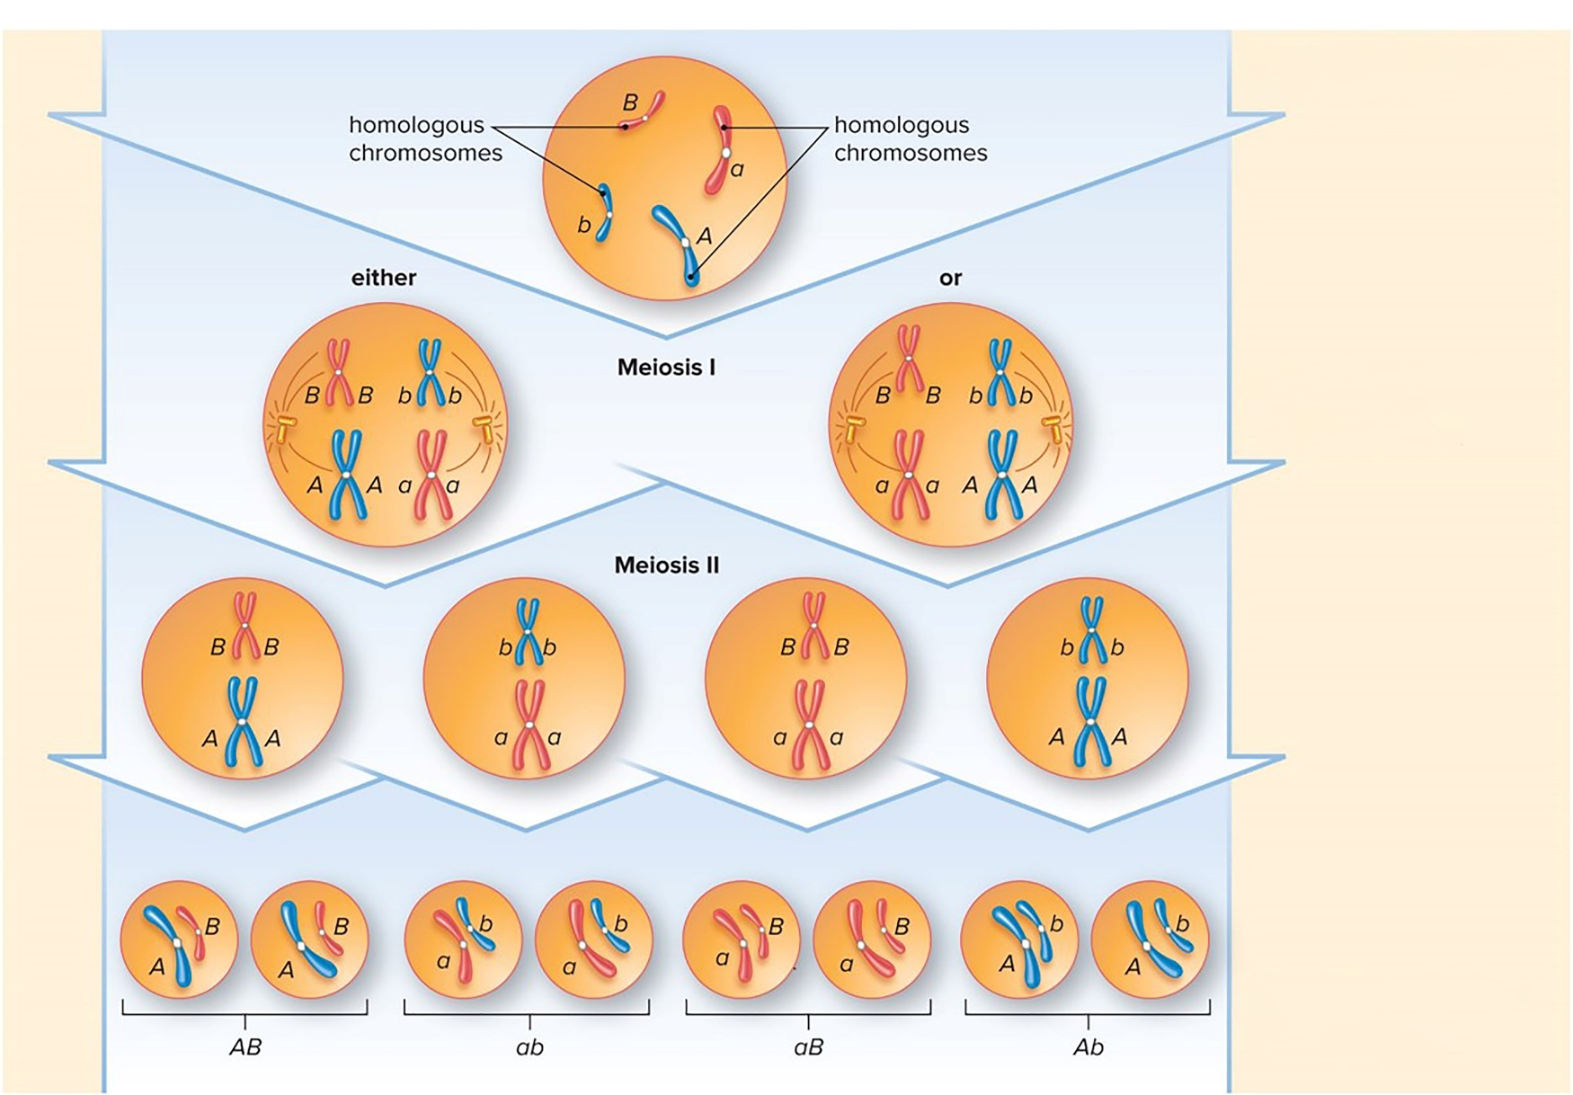
Figure 10.8 Mendel's Laws and Meiosis
Parent cell has two pairs of homologues.
Homologues can align either way during metaphase I.
All possible combinations of chromosomes and alleles result.

Slide 28
10.2 Mendel’s Laws Apply to Humans
Pedigree
Chart of a family’s history in regard to a particular genetic trait
Males are squares
Females are circles
Shading represents individuals expressing disorder
Horizontal line between circle and square is a union
Vertical line down represents children of that union
Counselor may already know pattern of inheritance and then can predict chance that a child born to a couple would have the abnormal phenotype

Slide 29
Pedigrees for Autosomal Disorders
Pedigrees for autosomal disorders
Autosomal recessive disorder
Child can be affected when neither parent is affected
Heterozygous parents are carriers.
Parents can be tested before having children.

Slide 30
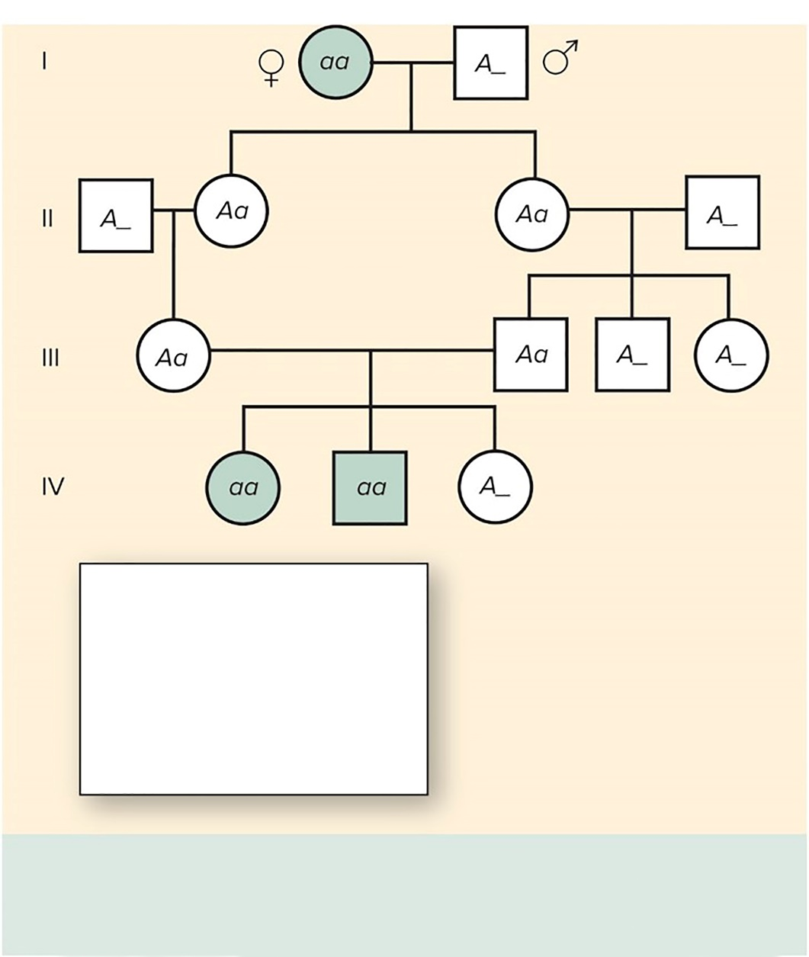
Figure 10.9 Autosomal Recessive Pedigree
Key:
aa = affected
Aa = carrier
(normal)
AA = normal
A_ = normal
(one allele unknown)
Affected children can have unaffected parents.
Heterozygotes (Aa) have a normal phenotype.
Both males and females are affected with equal frequency.

Slide 31
Autosomal Dominant Disorder
Autosomal dominant disorder
Child can be unaffected even when parents are heterozygous and therefore affected
When both parents are unaffected, none of their children will have the condition.
No dominant gene to pass on

Slide 32
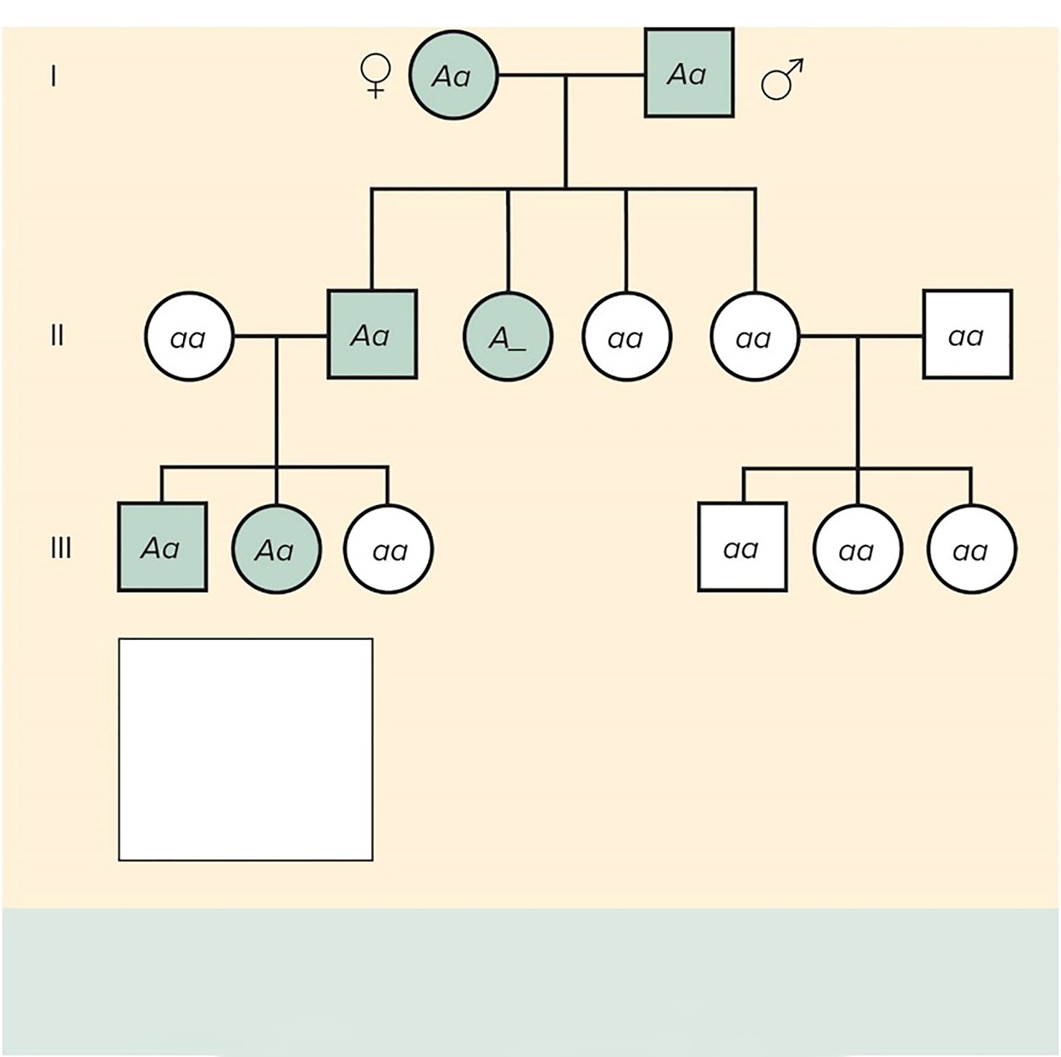
Figure 10.10 Autosomal Dominant Pedigree
Key:
AA = affected
Aa = affected
A_ = affected
aa = normal
Affected children will have at least one effected parent.
Heterozygotes (Aa) are affected.
Both males and females are affected with equal frequency.

Slide 33
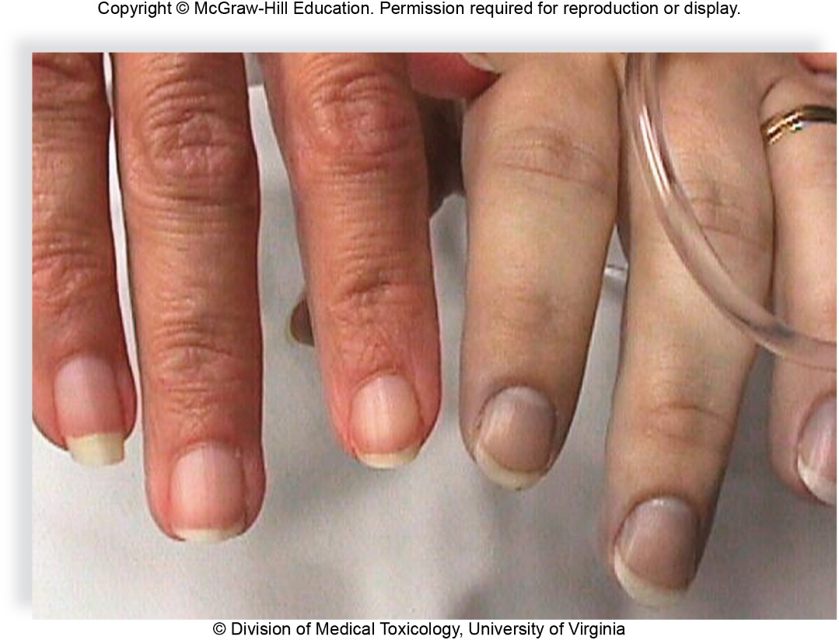
Genetic Disorders of Interest
Genetic disorders of interest
Autosomal disorders
Methemoglobinemia—lack enzyme to convert methemoglobin back to hemoglobin
Relatively harmless, bluish-purplish skin
© Division of Medical Toxicology University of Virginia

Slide 34
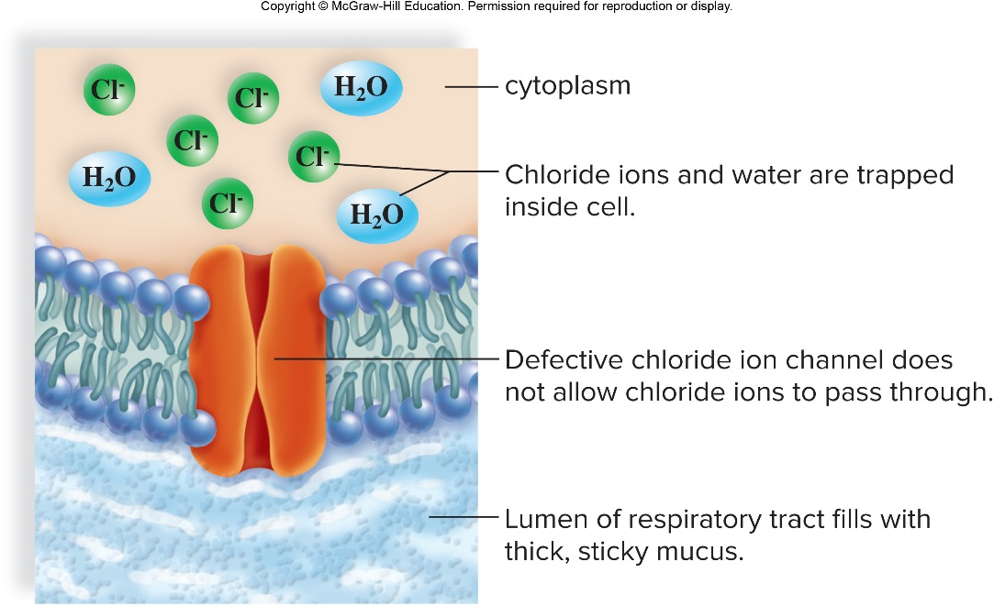
Cystic Fibrosis
Cystic fibrosis—autosomal recessive disorder
Most common lethal genetic disorder among Caucasians in U.S.
Chloride ion channel defect causes abnormally thick mucus

Slide 35
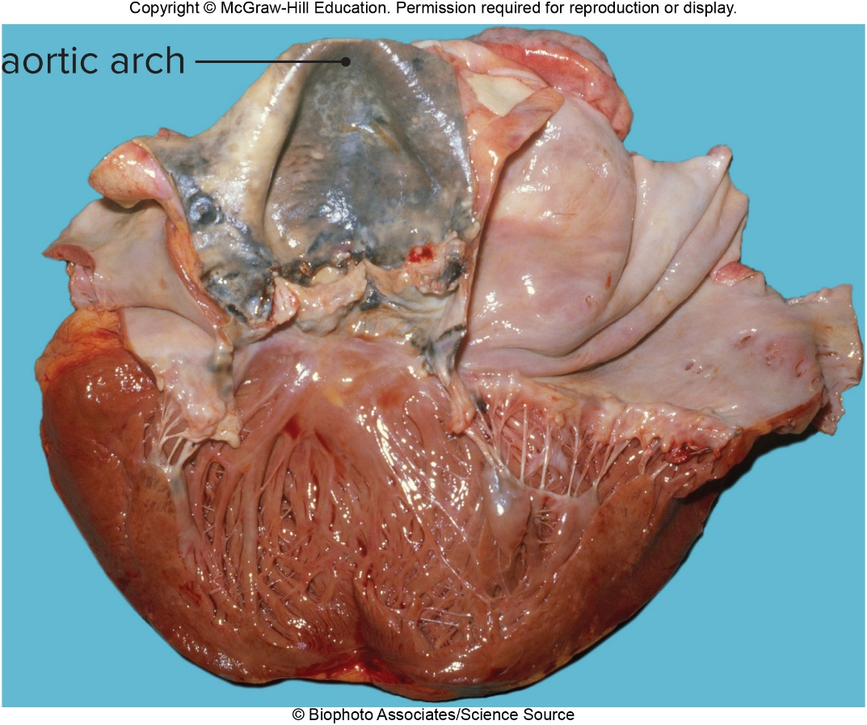
Alkaptonuria
Alkaptonuria—autosomal recessive disorder
Lack functional homogentisate oxygenase gene
Accumulation of homogentisic acid turns urine black when exposed to air
© Biophoto Associates/Science Source

Slide 36
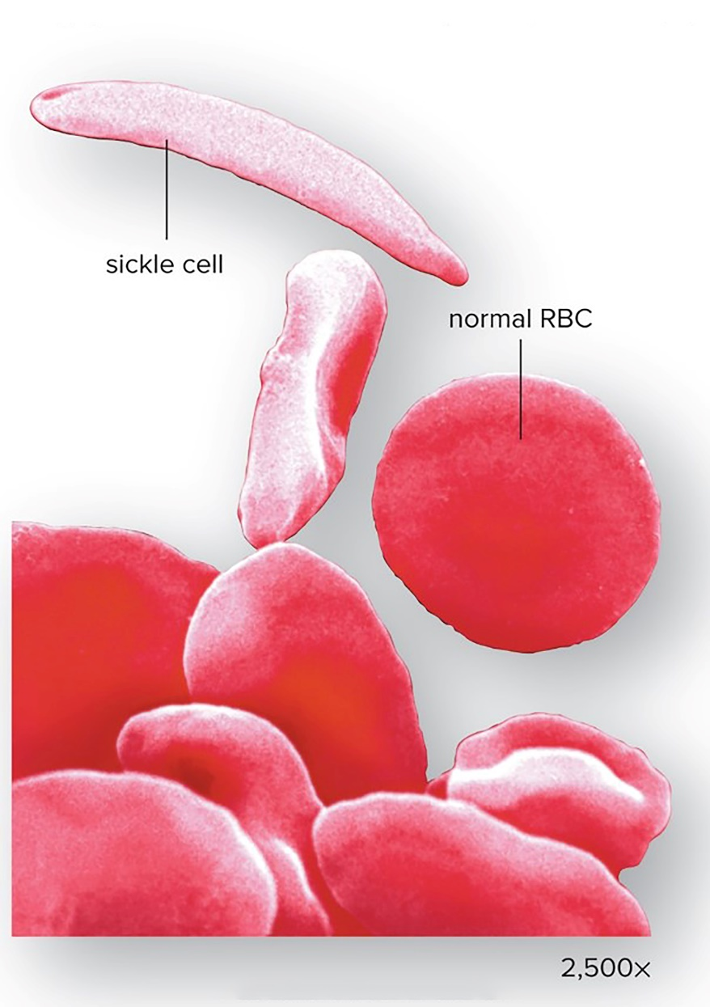
Sickle-Cell Disease
Sickle-cell disease —autosomal recessive disorder
Single base change in globin gene changes one amino acid in hemoglobin
Makes red blood cells sickle-shaped
Leads to poor circulation, anemia, low resistance to infection
© Dr. Gopal Murti/SPL/Science Source

Slide 37
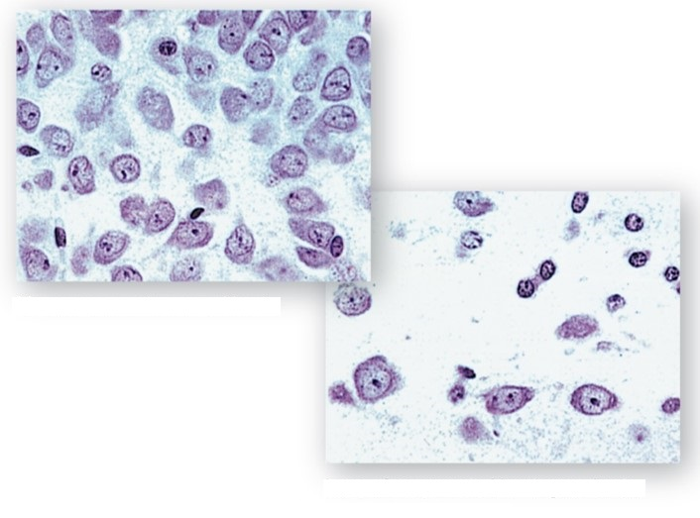
Huntington Disease
Huntington disease —autosomal dominant disorder
Progressive degeneration of neurons in brain
Mutation for huntingtin protein
Patients appear normal until middle-aged—usually after having children
Test for presence of gene
Many neurons in normal brain
Loss of neurons in Huntington brain
(both): © P. Hemachandra Reddy, Ph.D.

Slide 38
10.3 Beyond Mendel’s Laws
Incomplete dominance
Heterozygote has intermediate phenotype
Familial hypercholes-terolemia is an example in humans. Persons with one mutated allele have an abnormally high level of cholesterol in the blood, and those with two mutated alleles have a higher level still.
Human wavy hair is intermediate between curly and straight hair.

Slide 39
Figure 10.16 Incomplete Dominance
© Medical-On-Line/Alamy

Slide 40
Multiple-Allele Traits
Multiple-allele traits
ABO blood group inheritance has three alleles
$I^{A}$ = A antigen on red blood cells
$I^{B}$ = B antigen on red blood cells
i = neither A nor B antigen on red blood cells
Each person has only two of the three alleles
Both $I^{A}$ and $I^{B}$ are dominant to i
$I^{A}$ and $I^{B}$ are codominant—both will be expressed equally in the heterozygote
Type A = $I^{A}I^{A}$, $I^{A}i$
Type B = $I^{B}I^{B}$, $I^{B}i$
Type AB = $I^{A}I^{B}$ Type O = ii

Slide 41
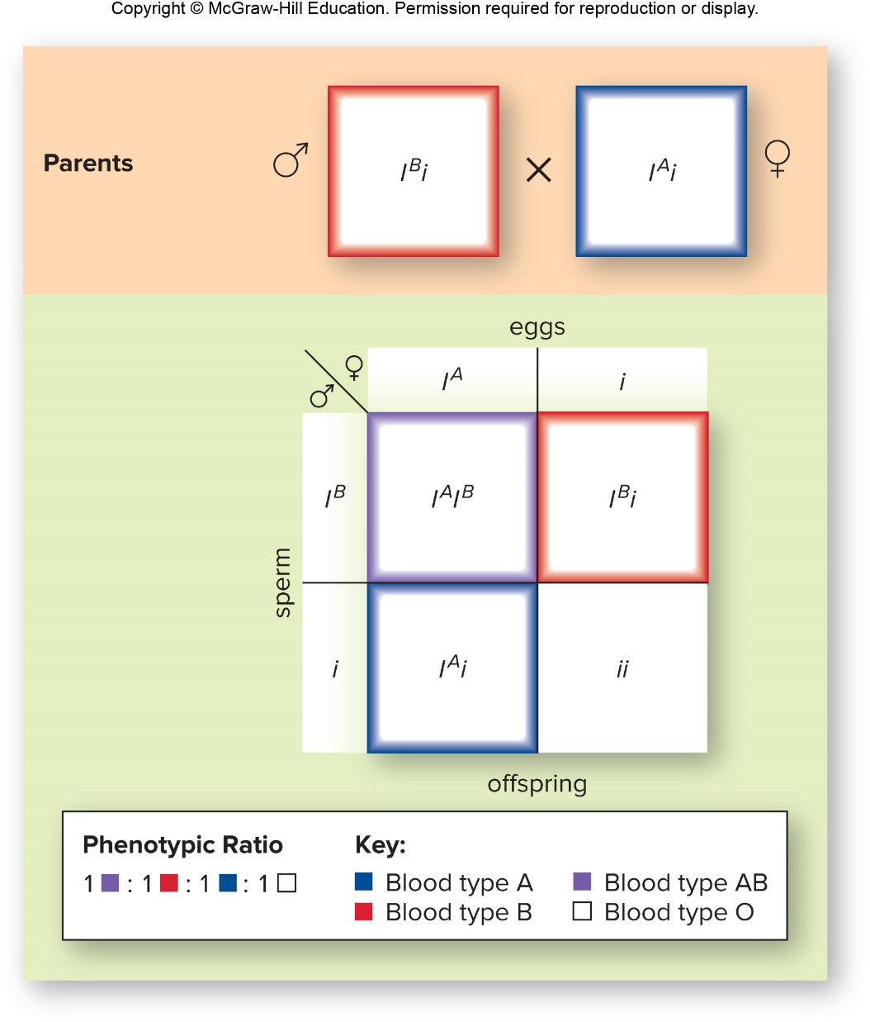
Figure 10.17 Inheritance of ABO Blood Type

Slide 42
Polygenic Inheritance
Polygenic inheritance
Trait is governed by two or more sets of alleles
Each dominant allele has a quantitative effect on phenotype and effects are additive
Result in continuous variation—bell-shaped curve
Multifactorial traits—polygenic traits subject to environmental effects
Cleft lip, diabetes, schizophrenia, allergies, cancer
Due to combined action of many genes plus environmental influences

Slide 43
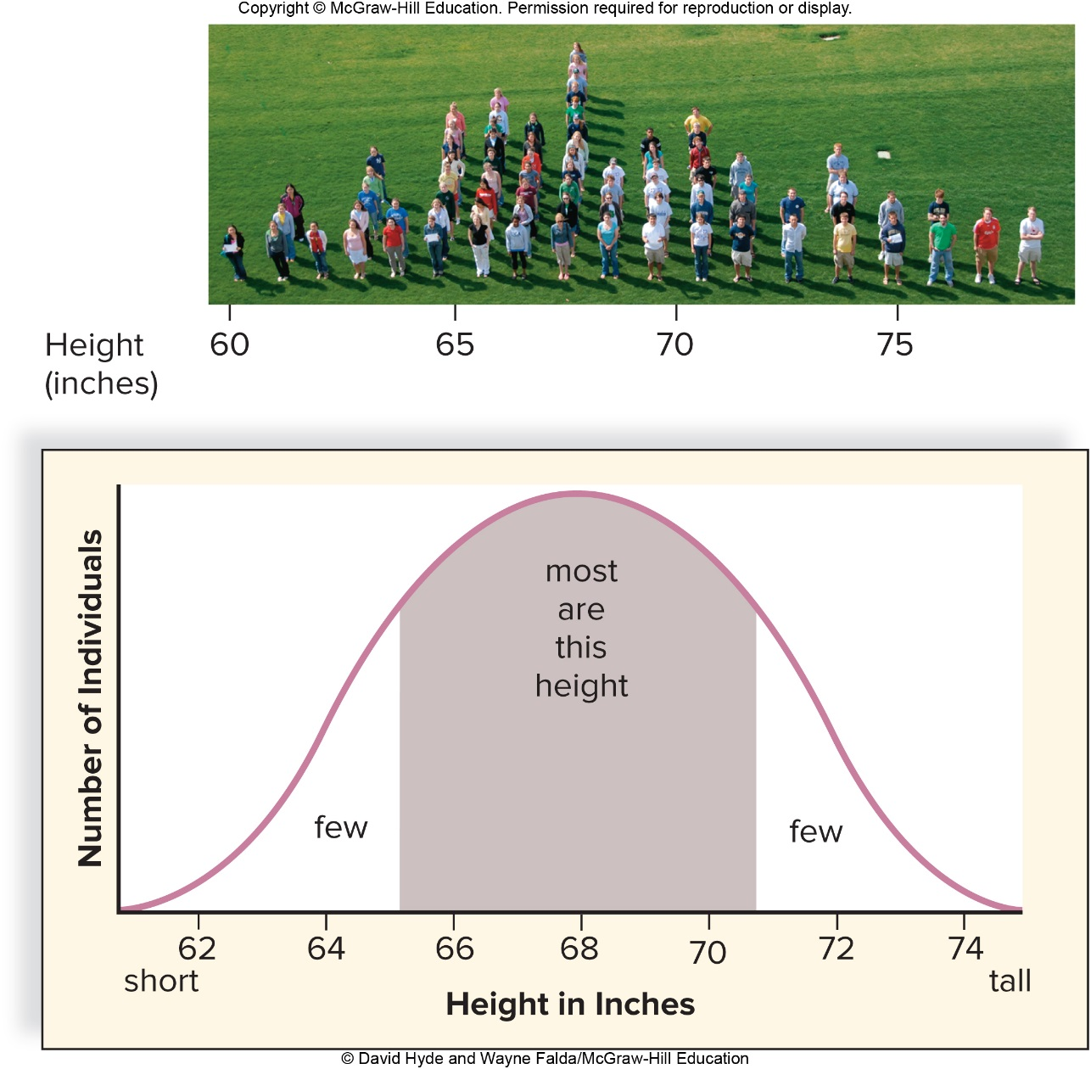
Figure 10.18 Height in Humans, a Polygenic Trait
© David Hyde and Wayne Falda/McGraw-Hill Education

Slide 44
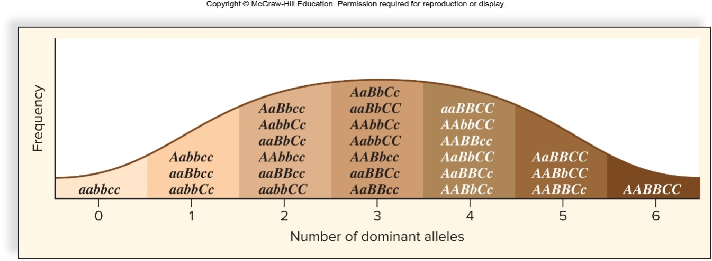
Environmental Influences
Environmental influences
In response to UV radiation, melanin is produced.
Human production of melanin in skin increases closer to the equator to protect skin from radiation.

Slide 45
Gene Interactions
Multiple pigments are involved in determining eye color
(red eye): © Mediscan/ Alamy Stock Photo; (brown eye): © Stylephotographs/123RF; (blue eye): © Lightpoet/123RF

Slide 46
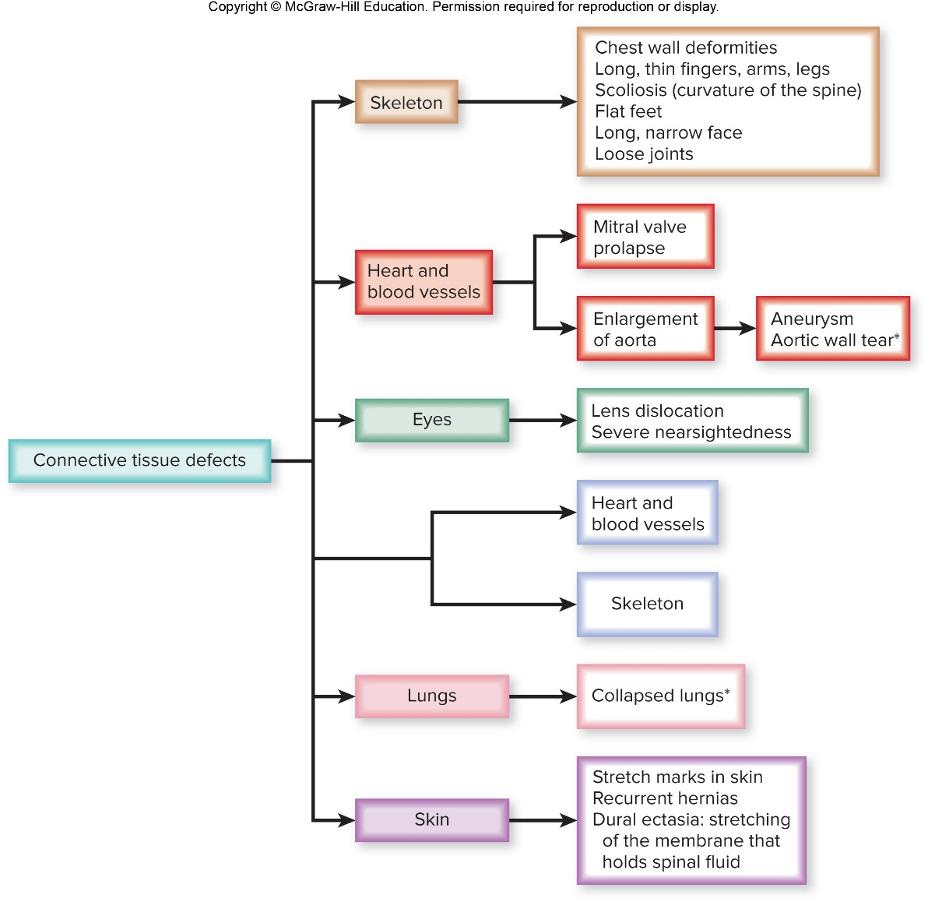
Figure 10.21 Marfan Syndrome, Multiple Effects of a Single Human Gene

Slide 47
Pleiotropy
Pleiotropy
Single genes have more than one effect.
Marfan syndrome is due to production of abnormal connective tissue.

Slide 48
Linkage
Two traits on same chromosome—gene linkage
Two traits on same chromosome do NOT segregate independently
Recombination between linked genes
Linked alleles stay together—heterozygote forms only two types of gametes, produces offspring only with two phenotypes

Slide 49
10.4 Sex-Linked Inheritance
Females are XX
All eggs contain an X
Males are XY
Sperm contain either an X or a Y
Y carries SRY gene—determines maleness
X is much larger and carries more genes
X-linked—gene on X chromosome

Slide 50
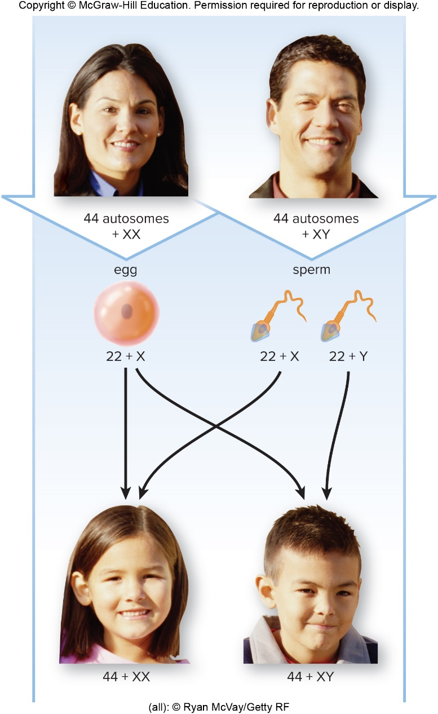
Figure 10.23 Sex Determination in Humans
(all): © Ryan McVay/Getty RF

Slide 51
Sex-Linked Alleles
Sex-linked alleles
Fruit flies have same sex chromosome pattern as humans
When red-eyed female mated with mutant white-eyed male, all offspring were red-eyed
In the $F_{2}$, the 3:1 ratio was found but all of the white-eyed flies were males
Y chromosome does not carry alleles for X-linked traits
Males always receive X from female parent, Y from male parent
Carrier—female who carries an X-linked trait but does not express it

Slide 52
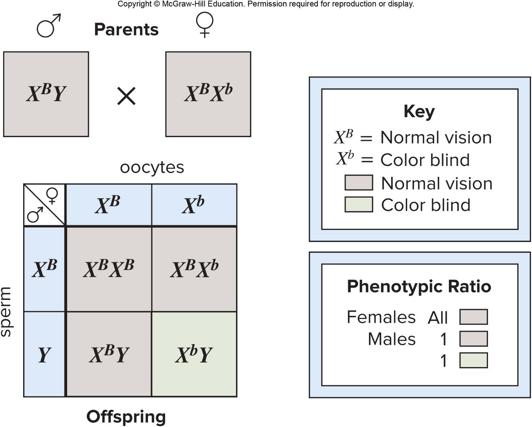
Figure 10.24 X-Linked Inheritance

Slide 53
Pedigree for Sex-Linked Disorder
Pedigree for sex-linked disorder
X-linked recessive disorder
Sons inherit trait from mothers—son’s X comes from mother
More males than females have disorder—allele on X is always expressed in males
Females who have the condition inherited the mutant allele from both their mother and their father
Conditions appear to pass from grandfather to grandson

Slide 54
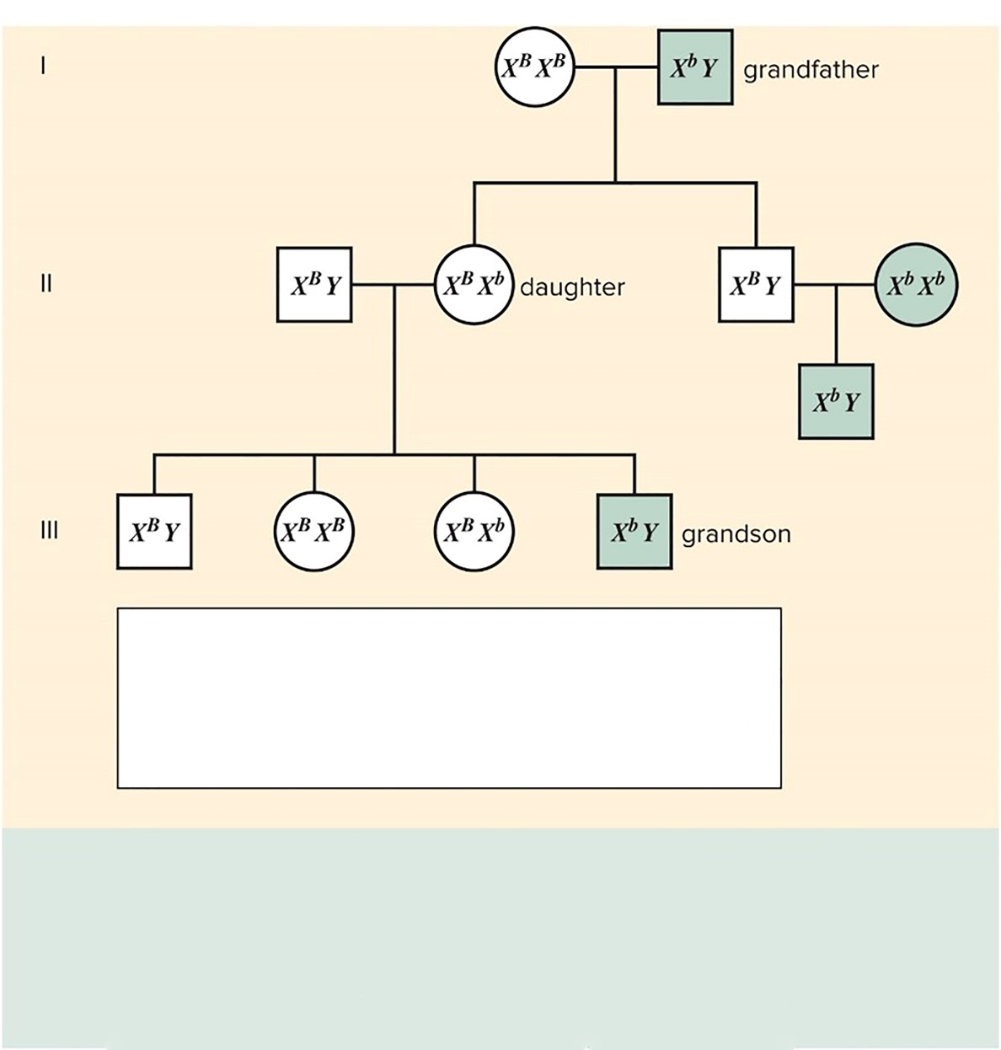
Figure 10.25 X-Linked Recessive Pedigree
Key:
$X^{B}X^{B}$ = normal female $X^{B}Y$ = normal male
$X^{B}X^{b}$ = carrier female $X^{b}Y$ = color-blind male
$X^{b}X^{b}$ = color-blind female
More males than females are affected.
An affected son can have parents who have the normal phenotype.
For a female to have the characteristic, her father must also have it. Her mother must have it or be a carrier.

Slide 55
X- and Y-Linked Disorders
X-linked dominant
Only a few traits
Daughters of affected males have the condition
Affected females can pass condition to daughters and sons
Depends on which X inherited from a carrier mother if father is normal
Y chromosome
Only a few disorders
Present only in males and are passed to all sons but not daughters

Slide 56
X-Linked Recessive Disorders
X-linked recessive disorders
Color blindness
About 8% of Caucasian men have red-green color blindness.
Duchenne muscular dystrophy
Absence of protein dystrophin causes wasting away of muscles
Therapy—immature muscle cells injected into muscles

Slide 57
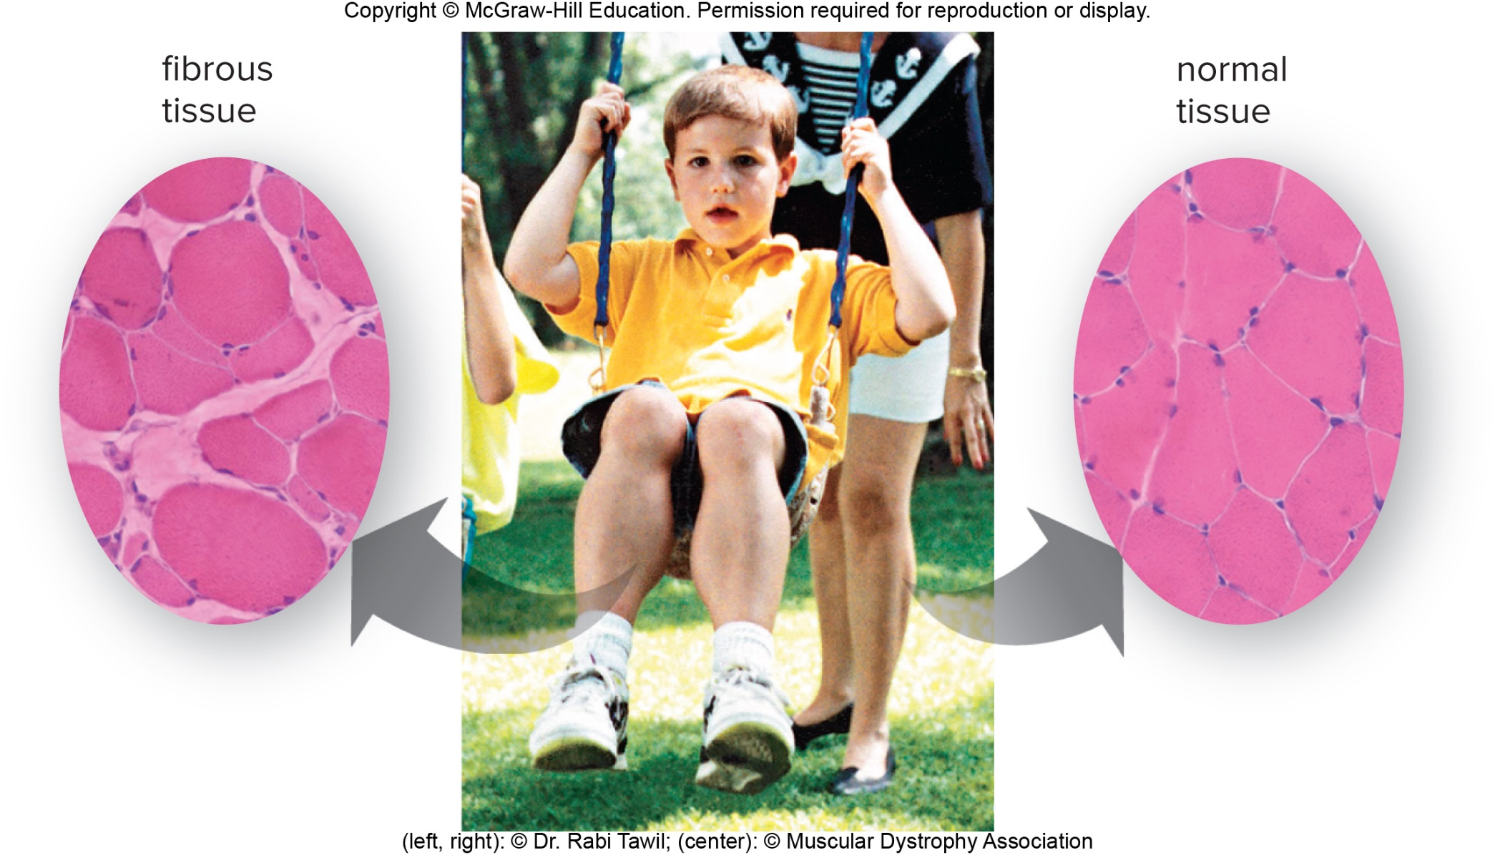
Figure 10.26 Muscular Dystrophy
(left, right): © Dr. Rabi Tawil; (center). © Muscular Dystrophy Association

